Slide 1
Basic SQL
SQL Day 1 Class

Slide 2
Learning Objectives
By the end of this lesson, you will be able to:
Define SQL, statement, and query
Use SELECT to query fields from a table
Notes:
"Welcome everyone to today's lesson on SQL and SELECT queries. By the end of this lesson, you will have gained some fundamental knowledge about SQL and be able to perform basic queries using the SELECT statement. Let's dive right in!
First, we'll start by defining three key terms:
SQL, which stands for Structured Query Language, is a powerful programming language specifically designed for managing and manipulating relational databases. It provides a standardized way to interact with databases.
A statement in SQL refers to a single instruction or command that performs a specific action within the database. SQL offers various types of statements, and today, we'll focus on the SELECT statement.
Lastly, a query is a specific request for data from a database. It's essentially a question you pose to the database, asking for specific information. We'll learn how to construct queries using the SELECT statement in this session.
So, by the end of this lesson, you'll not only have a clear understanding of these fundamental terms but also be able to utilize the SELECT statement to extract data from a database table. Let's get started!"

Slide 3
Defining SQL

Slide 4
Defining SQL
SQL (Structured Query Language) is the cornerstone of modern database management.
It serves as the universal programming language for data management in databases.
SQL seamlessly integrates with widely-used database systems such as Oracle, MySQL, SQL Server, and others.
SQL's declarative nature allows you to specify what data you want without getting bogged down in how to retrieve it.
Its user-friendly, English-like syntax makes SQL accessible and easy to learn.
Notes:
Speaker Notes:
Welcome to our introduction to SQL, the language that forms the bedrock of modern database management. Let's explore why SQL is so important for anyone diving into the world of data and databases.
SQL: The Cornerstone:
SQL, which stands for Structured Query Language, is like the foundation of a strong building. It's what makes modern database management possible.
Universal Data Language:
Think of SQL as a universal language for managing and working with data in databases. Whether you're dealing with customer information, inventory records, or any other data, SQL is your go-to tool.
Compatible with Popular Systems:
SQL is versatile. It can seamlessly work with widely-used database systems like Oracle, MySQL, SQL Server, and more. This means your SQL skills are transferable and valuable across different database platforms.
Declarative and User-Friendly:
One of SQL's standout features is its declarative nature. You don't need to worry about how to retrieve data; you simply specify what you want, and SQL takes care of the rest. It's like telling someone what you want to eat at a restaurant without needing to know how to cook it.
SQL's user-friendly, English-like syntax further simplifies your journey. Even if you're not a tech expert, SQL is designed to be accessible and easy to learn.
In summary, SQL is your key to efficiently manage and work with data, no matter where your career takes you. It's versatile, user-friendly, and empowers you to make the most of data in a digital age. Let's dive deeper into SQL and explore its practical applications!

Slide 5
Why Learn SQL?
SQL is indispensable for numerous technology roles, encompassing:
Database Administrators
Data Analysts
Data Engineers
Application Developers
Proficiency in SQL empowers professionals to effectively interact with data-driven systems.
SQL proficiency unlocks career opportunities across industries reliant on databases.
Adding SQL to your technical skill set enhances your overall capabilities and value.
Notes:
Speaker Notes:
Today, we're going to explore the pivotal role that SQL plays in various technology careers, especially for those new to the world of data and analytics.
SQL: Essential for Technology Roles:
SQL isn't just a niche skill; it's an indispensable tool for a broad spectrum of technology roles. Whether you're aiming to become a Database Administrator, Data Analyst, Data Engineer, or an Application Developer, SQL is a fundamental skill that will be at the heart of your daily work.
Empowering Data Interaction:
Mastering SQL empowers you to confidently engage with data-driven systems. It's like having a set of keys that unlocks the doors to valuable insights and decision-making.
Opening Doors to Career Opportunities:
SQL proficiency isn't just limited to a single industry; it transcends boundaries. It opens doors to career opportunities in various sectors that heavily rely on databases, from finance to healthcare, e-commerce to education.
Enhancing Your Skill Set:
Think of SQL as a valuable upgrade to your technical skill set. It's not just about landing new roles; it's about excelling in your current position by harnessing the power of data.
So, as you embark on your journey into the world of data and technology, keep in mind that SQL is your passport to countless possibilities. It's a versatile skill that will help you thrive in a data-driven world and enhance your career prospects. Let's continue this exciting journey!

Slide 6
Defining a Query

Slide 7
What is a Query?
A query is a specific request for data from a database.
It is a type of SQL statement that retrieves information from one or more tables.
Queries are used to interact with databases and retrieve meaningful insights from stored data.
SQL queries can be simple, retrieving individual records, or complex, involving multiple tables and advanced filtering criteria.
The results of a query are presented in a structured format that makes it easy to analyze and work with the retrieved data.
Notes:
Speaker Notes:
Let's dive deeper into the concept of a query in the context of databases and SQL.
What is a Query?
At its core, a query is a specific request for data from a database. Think of it as your way of asking the database to provide you with specific information.
A Type of SQL Statement:
In the world of SQL, a query is a type of SQL statement. Its primary purpose is to retrieve information from one or more tables within the database.
Interacting with Databases:
Queries are a fundamental tool for interacting with databases. They enable you to extract meaningful insights from the data stored within the database.
Simple to Complex:
SQL queries can range from simple to highly complex. A simple query might retrieve individual records, while a complex one could involve multiple tables, advanced filtering criteria, and calculations.
Structured Results:
The results of a query are presented in a structured format, making it easy to analyze and work with the retrieved data. This structure allows you to make informed decisions and gain valuable insights.
In summary, a query is your means of communicating with a database to access and retrieve the specific data you need. Whether you're looking for basic information or conducting in-depth analysis, SQL queries are your pathway to harnessing the power of data.

Slide 8
What is a Query?
SQL queries can be categorized into various types based on their purpose and functionality.
Common types of SQL queries include:
SELECT Queries: Retrieve data from one or more tables.
INSERT Queries: Add new data records into a table.
UPDATE Queries: Modify existing data records in a table.
JOIN Queries: Combine data from multiple tables.
AGGREGATE Queries: Perform calculations on data (e.g., SUM, AVG, COUNT).
Notes:
Speaker Notes:
Let's explore the different types of SQL queries, which are like tools in your data toolbox.
Types of SQL Queries:
SQL queries are categorized into various types, each with its own purpose.
1. SELECT Queries:
These queries are for retrieving data from tables. Imagine it as grabbing specific items from a shelf.
2. INSERT Queries:
Use INSERT queries to add new data to tables, like putting new items on the shelf.
3. UPDATE Queries:
Think of UPDATE queries as editing existing items on the shelf, making changes.
4. DELETE Queries:
DELETE queries remove data from tables, just like removing items from the shelf.
5. JOIN Queries:
JOIN queries combine data from multiple tables, like merging two shelves into one.
6. AGGREGATE Queries:
These queries perform calculations on data, such as finding the total or average.
Versatile Tools:
Each type of query serves a unique purpose and is a versatile tool in your SQL toolkit. Depending on your data manipulation and analysis needs, you can choose the appropriate query type to achieve your objectives.
Understanding these query types will empower you to work effectively with databases, retrieve the data you need, and perform various data operations.

Slide 9
SQL Clause

Slide 10
SQL Statements
SQL is written in statements - strings of characters that conform to formatting and syntax rules specified in the international standard
For example, a basic SELECT statement fetching data from a Customers table would be:
SELECT id, name, address
FROM Customers
WHERE state = 'CA’
ORDER BY name;
Notes:
Speaker Notes:
Let's dive into the core of SQL: statements. SQL commands are expressed as statements, which are essentially strings of characters that adhere to internationally recognized formatting and syntax rules.
Example of an SQL Statement:
To illustrate, consider a basic SQL statement: the SELECT statement. This statement is used to retrieve data from a table, in this case, a table named Customers.

Slide 11
SQL Statements
Writing an SQL statement involves several key steps, which help you communicate effectively with the database engine.
The first step is to specify the operation type. Common operation types include SELECT, INSERT, UPDATE, and DELETE.
Let's take a closer look at an example using the SELECT statement to query data from a Customers table.
SELECT id, name, address
FROM Customers
WHERE state = 'CA’
ORDER BY name;
Notes:
Speaker Notes:
Let's uncover the process of crafting an SQL statement step by step, which is essential to communicate effectively with the database engine.
Step 1: Specify the Operation Type:
The very first step in writing an SQL statement is to specify the operation type. This tells the database engine what you want to do with the data. Here are some common operation types:
SELECT: Used for querying data from one or more tables.
INSERT: Employed to add new data records to a table.
UPDATE: Utilized to modify existing data records.
DELETE: Applied to remove data records from a table.
Example Using SELECT:
In the example provided, we're using the SELECT statement, which is typically used to query data from a table. Specifically, we want to retrieve 'id,' 'name,' and 'address' columns from a table named Customers.

Slide 12
SQL Statements
Writing an SQL statement involves:
Specify the table and columns:
The statement needs to indicate from which database table and columns you want to access or operate on. Often this is done after the operation type using a FROM clause.
SELECT id, name, address
FROM Customers
WHERE state = 'CA’
ORDER BY name;
Notes:
Now, let's dive deeper into the process of crafting SQL statements and focus on a crucial component: specifying the table and columns.
Specify the Table and Columns:
After specifying the operation type in your SQL statement, the next critical step is to indicate the database table and the specific columns you want to access or operate on.
Using the FROM Clause:
This is typically achieved using the FROM clause. The FROM clause tells the database engine which table you want to work with.
Example SQL Statement:
In our example, we're using the SELECT statement, which is designed for querying data. After the SELECT operation, we specify the table 'Customers' using the FROM clause.
The choice of table and columns in your SQL statement is crucial because it determines exactly which data you are accessing or operating on. It's like pointing your finger to the specific information you want to work with.
So, as you craft your SQL statements, remember that specifying the right table and columns is key to getting the results you need from your database.

Slide 13
SQL Statements
Writing an SQL statement involves:
Specify any filtering conditions (optional):
You can filter which data rows you want using a WHERE clause and conditional logic.
SELECT id, name, address
FROM Customers
WHERE state = 'CA’
ORDER BY name;
Notes:
Speaker Notes:
As we continue to explore the art of crafting SQL statements, let's focus on another key aspect: specifying filtering conditions.
Specify Filtering Conditions (Optional):
While not always required, specifying filtering conditions allows you to narrow down your data selection based on specific criteria. This is an optional but powerful step in SQL statement creation.
Using the WHERE Clause:
In SQL, filtering conditions are typically added using a WHERE clause. The WHERE clause employs conditional logic to determine which data rows meet the specified criteria.
Example SQL Statement:
In our example, we're using the SELECT statement to query data from the 'Customers' table.
However, we're not interested in all customers; we want to filter for those located in California. To achieve this, we include a WHERE clause with the condition 'state = 'CA''.
This means that only rows where the 'state' column equals 'CA' will be included in the result set.
By adding filtering conditions to your SQL statements, you gain precise control over the data you retrieve or manipulate, ensuring that it aligns with your specific needs and criteria. It's like applying a magnifying glass to focus on the exact information you require.

Slide 14
SQL Statements
Writing an SQL statement involves:
Specify sorting/grouping (optional):
Statements like ORDER BY and GROUP BY can control row sorting and grouping in the output.
SELECT id, name, address
FROM Customers
WHERE state = 'CA’
ORDER BY name;
Notes:
Let's continue our journey through crafting SQL statements by exploring the optional but valuable steps of specifying sorting and grouping options.
Specify Sorting and Grouping (Optional):
While it's not always necessary, you have the option to control how the rows in your SQL query result are sorted or grouped. This can greatly impact the readability and usefulness of your data.
Using ORDER BY for Sorting:
To sort rows in the output, you can use the ORDER BY clause followed by the column by which you want to sort. In our example, we're sorting the results by the 'name' column in ascending order.
Using GROUP BY for Grouping:
Additionally, you can use the GROUP BY clause to group rows based on common values in a specific column. This is especially useful when you want to perform aggregate functions on grouped data.
Example SQL Statement:
In the example provided, we're using the SELECT statement to query data from the 'Customers' table.
We've added a WHERE clause to filter for customers in California ('state = 'CA'').
Furthermore, we've included an ORDER BY clause to ensure that the results are presented in alphabetical order based on the 'name' column.
Adding sorting and grouping options to your SQL statements provides you with the flexibility to present and analyze data in a meaningful way. It's like arranging pieces of a puzzle to see the bigger picture.

Slide 15
SQL Statements
Writing an SQL statement involves:
End with a semicolon:
All SQL statements are terminated with a semicolon ";"
SELECT id, name, address
FROM Customers
WHERE state = 'CA’
ORDER BY name;
Notes:
As we wrap up our exploration of crafting SQL statements, there's one last important detail to keep in mind: adding the semicolon at the end.
End with a Semicolon:
All SQL statements must be terminated with a semicolon. Think of it as a period at the end of a sentence in the SQL language.
Example SQL Statement:
In the SQL statement example provided, you can see that it concludes with a semicolon after the ORDER BY clause.
Adding this semicolon is not just a formality; it's a crucial part of writing SQL correctly. It tells the database engine that your statement is complete and ready to be executed.
So, always remember to include that final semicolon in your SQL statements to ensure they work as intended. It's like placing the finishing touch on your data query or manipulation.

Slide 16
Recap

Slide 17
Summary
SQL Data Querying - Best Practices
SQL enables powerful data retrieval & manipulation
Flexible data access across tables
Optimization for fast performance
Tips for Efficiency:
Focus queries only on required columns and conditions
Look for inefficient scans or expensive operators
Improve Over Time:
Start simple and targeted, add complexity gradually
Validate results at each iteration
Practice makes efficient SQL use

Slide 18
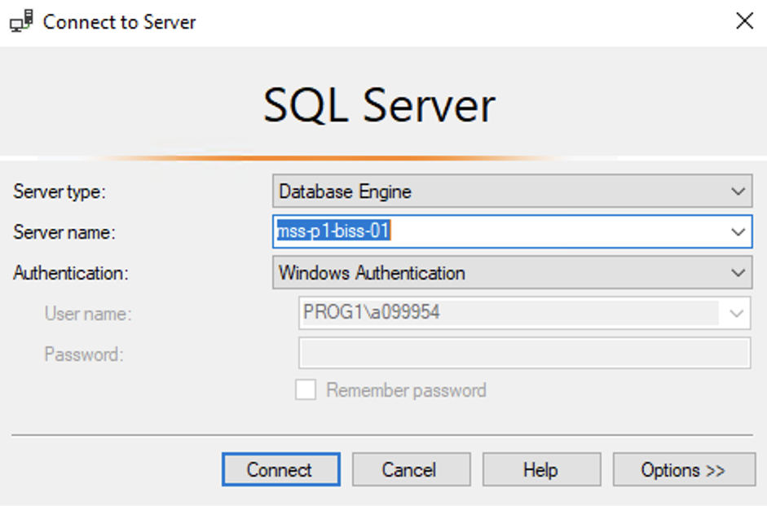
Hands On Examples
Using the AdventureWorks2012 Database
Please open up SSMS
Connect to BISS
Server = mss-p1-biss-01

Slide 19
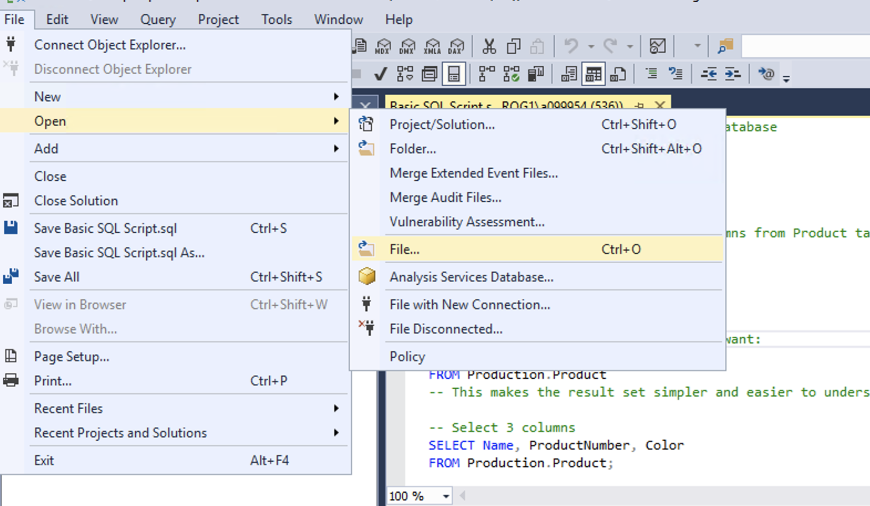
Hands On Examples
Click File -> Open -> File

Slide 20
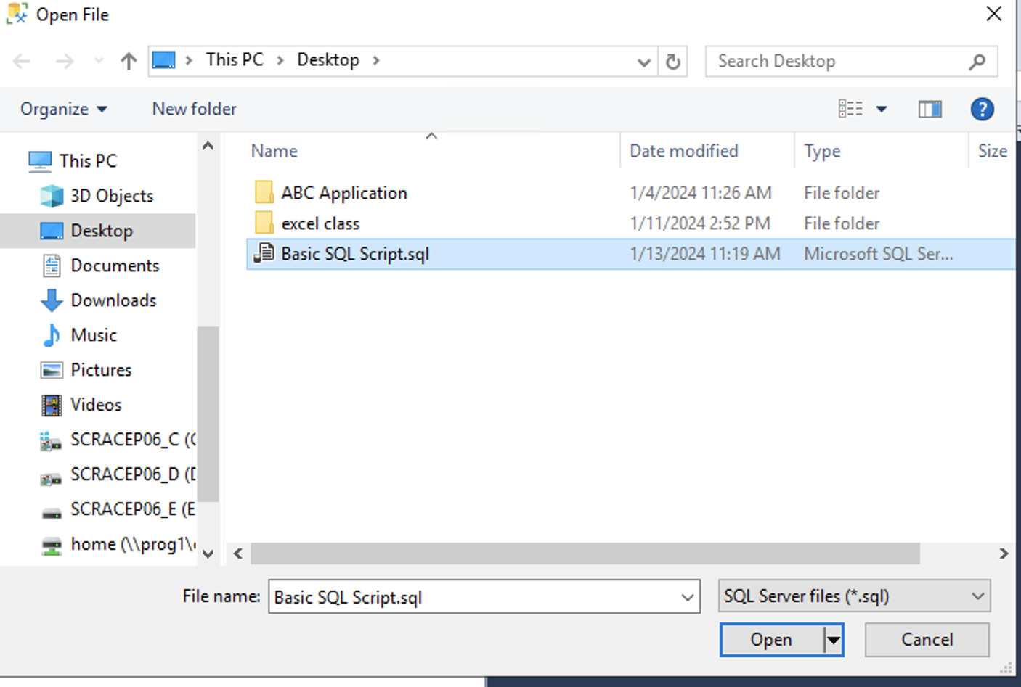
Hands On Examples
Open the SQL Day 1 Basic SQL Script.sql file
Notes:
Walk through each function

Slide 21
Exercise
Open the Day 1 Exercise.sql file
Answer the questions from each section
Notes:
Answers are stored in the Exercise Answers.sql file

